Slide 1
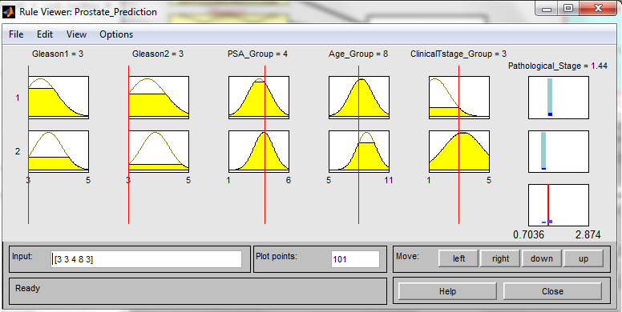
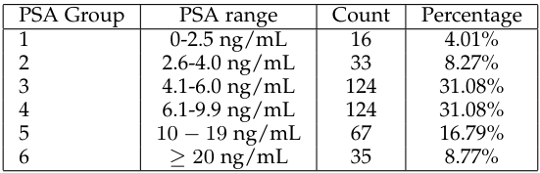
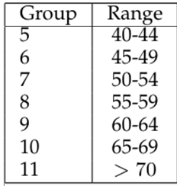
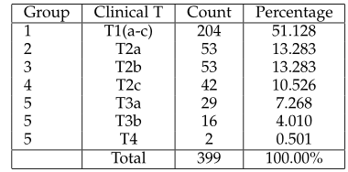
Prostate Cancer Staging Predictor
Output: Degree of membership (belongingness) into a cluster
1-4:OCD
5:ED

Slide 2
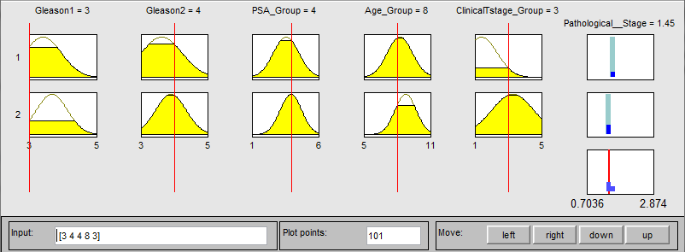
Prostate Cancer Staging Predictor
Output: Degree of membership (belongingness) into a cluster
1-4:OCD
5:ED

Slide 3
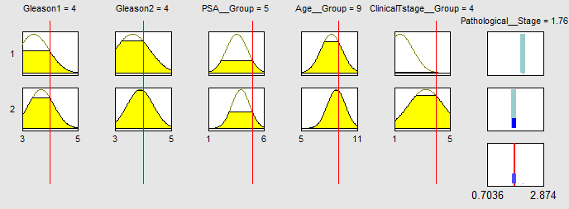
Prostate Cancer Staging Predictor

Slide 4
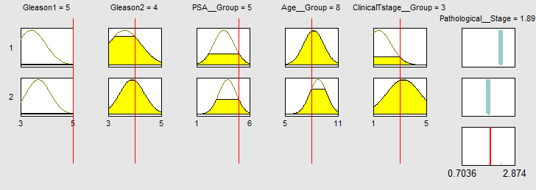
Prostate Cancer Staging Predictor

